Slide 1
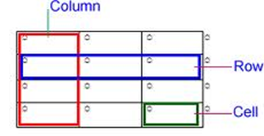

Tables : Splitting Cells, AutoFit and Gridlines

Slide 2
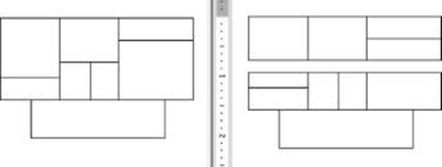
Splitting of Cells

Slide 4
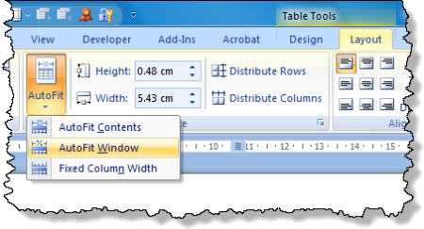
AutoFit

Slide 6
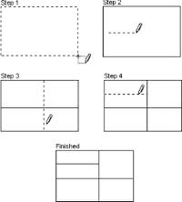
Gridlines

Slide 8


Activity
Learner’s worksheet in DataFiles_Solutions Folder

